Slide 1
PWC Website Proposal
Kailey Hanson, Olivia Garrett, Angie Stucker
November 17, 2014

Slide 2
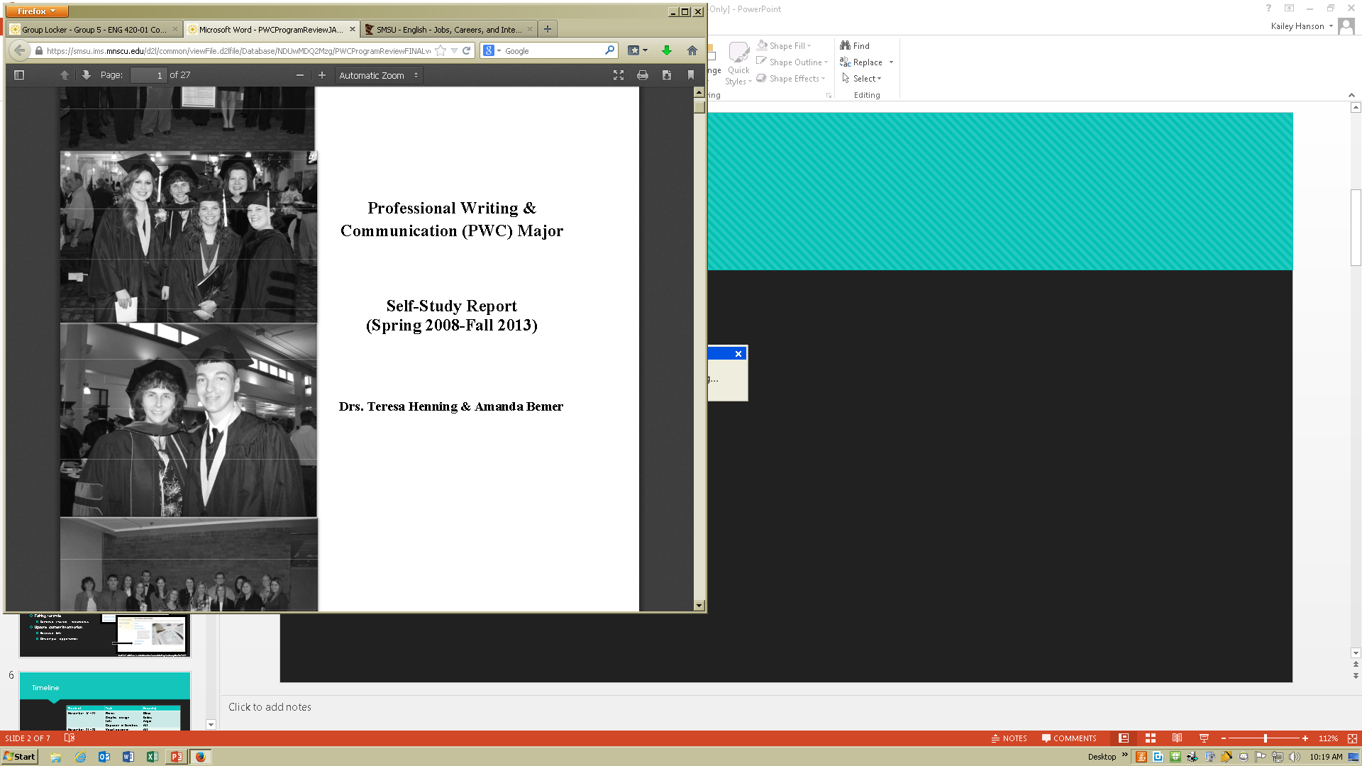
Background
What
Who
  Direct client
  Audiences
Why
  Purpose
  Interview
  Research
source: https://smsu.ims.mnscu.edu/d2l/common/viewFile.d2lfile/Database/NDUwMDQ2Mzg/PWCProgramReviewFINALversiondf?ou=2492905&display=1

Slide 3
Introduction
Overview
  Visual redesign
  Content review and updates
  Timeline
Through visual redesign and copyediting, the PWC website will serve as a more effective resource for its various audiences.

Slide 4
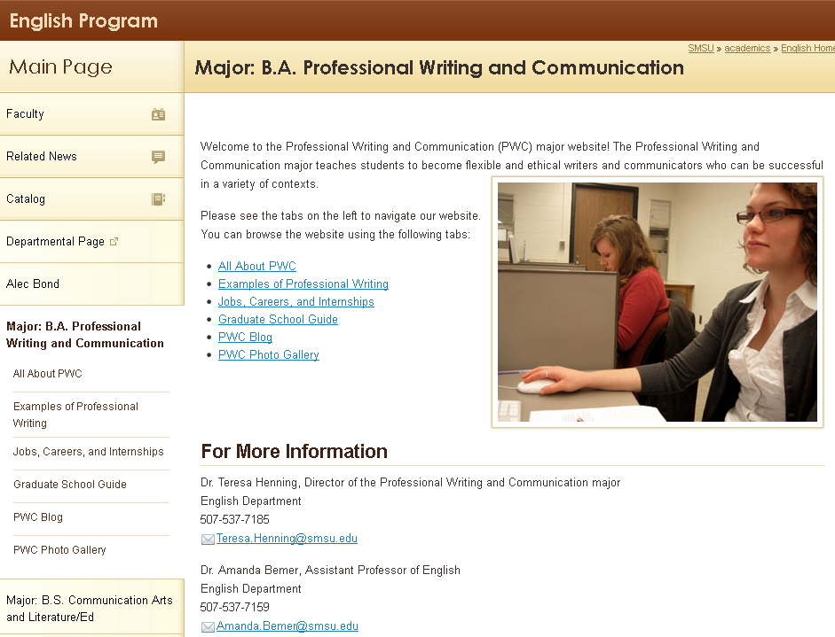
Visual Redesign
Display of information
  Paragraph length
  Lists/grouping
  Headings
  Photos
  Graphics
Functions
  Comprehension
  Usability
  Motivation
source: http://www.smsu.edu/academics/programs/english/?Id=3837

Slide 5
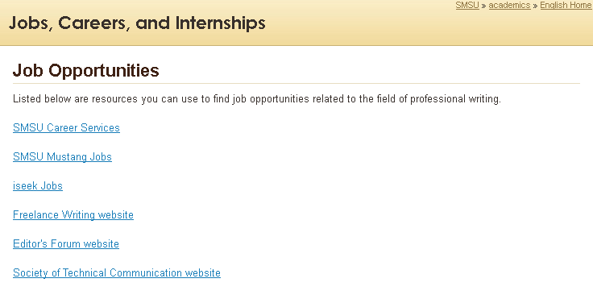
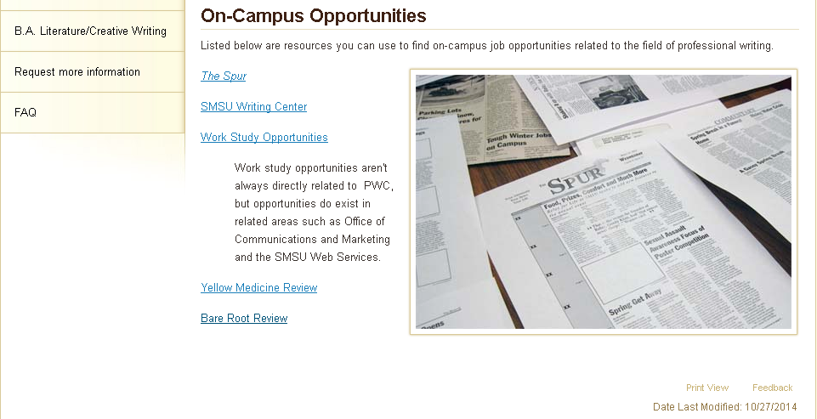

Content Review and Updates
Copyedit the information
  Capitalization, grammar, punctuation
Edit for style
  Sentence structure, redundancy
Update current information
  Resource links
  On-campus opportunities
source: http://www.smsu.edu/academics/programs/english/?id=6991

Slide 6
Timeline
Week of | Task | Person(s)
November 17 | Photos Graphic design Links Copyedit in Sandbox | Olivia Kailey Angie ALL
November 24 | Visual design in Sandbox | ALL
December 1 | Finalize website, create style sheet | ALL
December 8 | Write transmittal letter, collaboration report, course & group evaluations | ALL

Slide 7
Conclusion
Through visual redesign and copyediting, the PWC website will serve as a more effective resource for its various audiences.

